Slide 1

PETALS
pattern enhancement tool for assisting landmine sensing
home
about
press
papers
Harvard School of Engineering and Applied Sciences
links
people
projects
mines
Massachusetts Institute of Technology
Carnegie Mellon University
”The lucky thing is that MINES DON’T HAVE SEX.
Once cleared, mines are gone, finito…”
…

Slide 3
PETALS

Slide 4
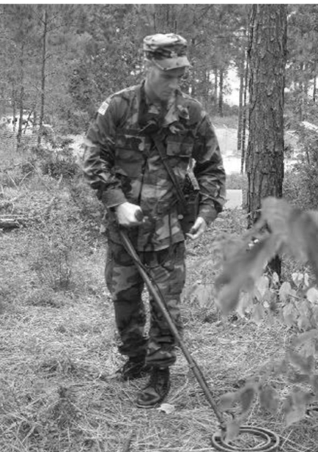
a
motivation
Post-conflict landmines have serious humanitarian repercussions: landmines cost lives, limbs and land. The primary method used to locate these buried devices relies on a human listening to audio feedback from a metal detector.
p
e
t
a
l
s
challenge
With this technique, the proximity of the human to the explosive device means that mistakes are potentially fatal. The presence of metallic debris in former combat areas also means that operators must discriminate landmine feedback from that induced by clutter in order to operate efficiently: in current practice, operators must stop and inspect every contact that could be a landmine, which slows down the demining process significantly. Both these challenges are exacerbated by newer landmines with minimal metallic content.
news
07.05.2010
Project wins Hoopes Prize
response
PETALS aims to respond to these challenges and improve the demining process through the provision of assistive visual interfaces for metal detector-based landmine detection.
28.06.2010
Project PETALS is named
30.06.2010
PETALS submits to UIST 2010
All rights reserved © Lahiru G. Jayatilaka 2010
Contact us : petals at seas dot harvard dot edu

Slide 5
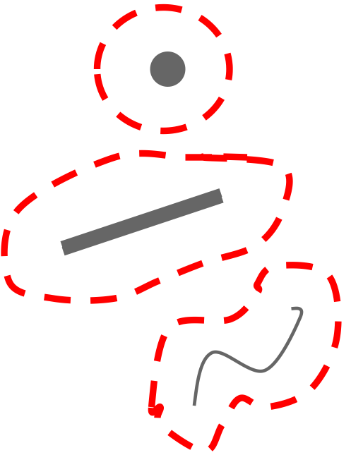
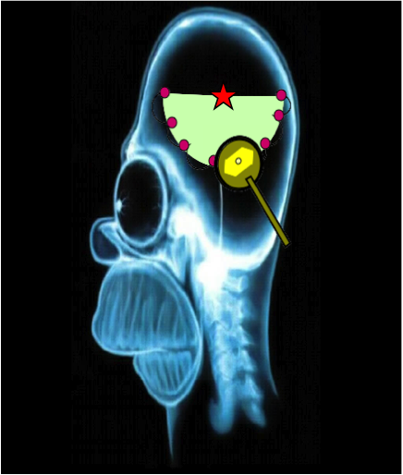
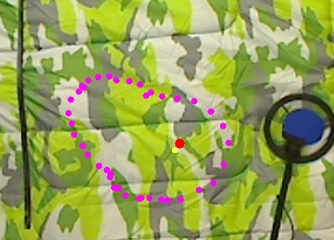
a
inspiration
Work in the area of cognitive engineering has suggested that expert deminers mentally construct spatial patterns to make detection decisions. These patterns are constructed by finding a point near a potential threat at which the metal detector responses start and stop. By systematically finding several such points, experts build spatial patterns (outline of the boundary points) of the metallic field belonging to the buried object or collection of objects. If the encountered pattern is similar to one belonging to a landmine in past experience, then the probability of a threat is high. By incorporating such procedures into demining training programs, researchers have been able to improve performance of novice deminers.
a
b
o
u
t
limits
This technique, however, relies on operators' creation and retention of mental models that are subject to cognitive limitations such as working memory capacity. A rough analogy: how well can you remember a random pattern that someone traces out for you using their finger?
idea
Why rely on memory at all? To circumvent cognitive limitations associated with internal representation we present PETALS. PETALS allows the operator to build and see these patterns on a display screen. In effect, it helps novice deminers answer two questions: i) is there a mine present? and ii) where is the mine located?
All rights reserved © Lahiru G. Jayatilaka 2010
Contact us : petals at seas dot harvard dot edu

Slide 6
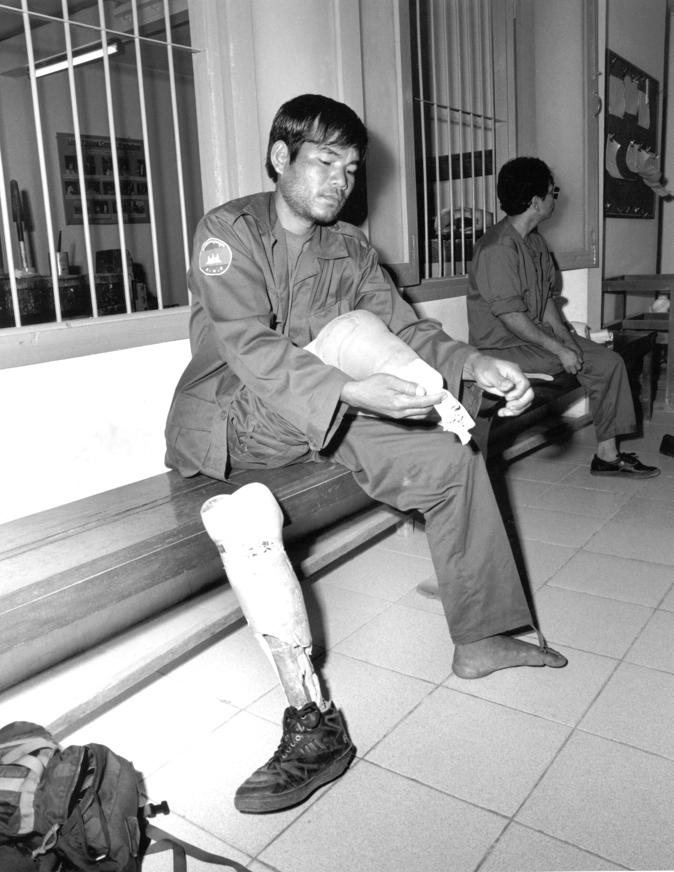
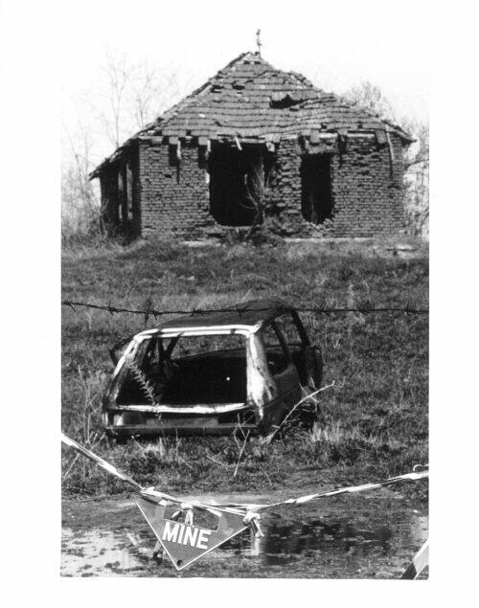
a
Hidden beneath the ground, a landmine is a passive explosive device usually triggered by pressure and used to deny access to military positions or strategic resources. After wars, landmines remain hidden within communities, indiscriminately killing and maiming innocent civilians. Landmines impose especially high economic costs on third world countries by increasing the number of disabled victims requiring medical care and government welfare, as well as rendering vast tracts of farmland unusable. They also freeze societies : how you would your town react if mines were randomly buried along sidewalks, roads and parks?
m
i
n
e
s
landmines
Affect over 70 countries. In 2008 over 500,000 were removed
lives
During 2008 alone, responsible for over 5000 casualties
limbs
Vietnam has an estimated 100,000 blast survivors
land
Nearly 13% of Cambodia's land mass is estimated to contain threats
All rights reserved © Lahiru G. Jayatilaka 2010
Contact us : petals at seas dot harvard dot edu

Slide 7




a
support
p
e
o
p
l
e
Sarath Jayatilaka, Hasini Jayatilaka, Ruwan Senaratne, Rebecca Cremona, Nushelle de Silva, Kurt Gray, Thrishantha Nanayakkara, Radhika Nagpal and Matt Welsh.
team
Krzysztof Gajos is an assistant professor in Computer Science at Harvard University with research interests in human-computer interaction, artificial intelligence and applied machine learning.
James Staszewski is a research professor of psychology at Carnegie Mellon with interests in analyzing the cognitive mechanisms underlying experts’ extraordinary proficiency and applying the findings to help learners increase their proficiency.
Luca Bertucelli is a postdoctoral associate at MIT with interests in robust planning, real-time adaptation and control, integrated human-unmanned systems, and distributed decision-making.
Lahiru Jayatilaka is a recent graduate of Harvard College interested in scientific research and development targeted at alleviating the global landmine problem.
All rights reserved © Lahiru G. Jayatilaka 2010
Contact us : petals at seas dot harvard dot edu

Slide 8
“When you take a battlefield, so many bombs have been dropped, so many shots have been fired – there’s just so much metallic debris,” says Lahiru. “More often than not it’s harmless – it’s a coke can or a bullet shell – but you have to act like it’s a mine. You have to go down on your knees and probe with a handheld tool.” Such ‘clutter’ can really slow down progress – and in a field where resources and manpower are scarce, it’s a significant problem. It’s the reason there’s such a discrepancy between the cost of laying a mine (low) and removing a mine (high).
Sunday Times, Sri Lanka, July 2010

Slide 9
a
PETALS: a visual interface for landmine detection
Visualizing patterns : decision support for human-based demining
p
a
p
e
r
s
This short paper presents a novel interface (PETALS) that is designed to assist with building and visualizing spatial patterns, rather than relying on memory alone.
Undergraduate thesis that examines the effects of showing novice deminers spatial patterns on a visual interface in relation to the traditional method of internal representation.
Spatial thinking and the design of landmine detection training
Mine detection training based on expert skill
This book chapter details two projects that incorporated expert techniques of spatial pattern building into novice deminer training programs.
Presents studies that tested the effects of an experimental detection training program based on knowledge and techniques learned from analysis of deminer expertise.
<< prev
next >>
All rights reserved © Lahiru G. Jayatilaka 2010
Contact us : petals at seas dot harvard dot edu

Slide 10
a
p
r
e
s
s
Under construction
All rights reserved © Lahiru G. Jayatilaka 2010
Contact us : petals at seas dot harvard dot edu

Slide 11
a
p
r
o
j
e
c
t
s
Under construction
All rights reserved © Lahiru G. Jayatilaka 2010
Contact us : petals at seas dot harvard dot edu

Slide 12



a
MAIC
The Center for International Stabilization and Recovery's Mine Action Information Center (CISR/MAIC) is a public policy center which manages information and conducts training relevant to humanitarian mine clearance, victim assistance, mine risk reduction and other landmine-related issues.
l
i
n
k
s
LM
Landmine and Cluster Munition Monitor is a civil society-based program providing research and monitoring on progress made in eliminating landmines, cluster munitions, and other explosive remnants of war.
ICBL
ICBL is a global network in over 70 countries working for a ban on landmines and cluster munitions, co-laureate of the 1997 Nobel Peace Prize.
E-Mine
The United Nations electronic mine information network is an information gateway developed to support both the planning and coordination of global mine action efforts.
Handicap
Handicap International is an international solidarity organization specialized in the field of disability. It works alongside people with disabilities, whatever the context, offering them assistance and supporting them in their efforts to become self-reliant.
Book
Humanitarian demining contains three technical research sections written by well recognized researchers in the field worldwide. The topics are: Humanitarian Demining: the Technology and the Research Challenges, Sensors and Detection Techniques for Humanitarian Demining, and Robotics and Flexible Mechanisms for Humanitarian Demining.
All rights reserved © Lahiru G. Jayatilaka 2010
Contact us : petals at seas dot harvard dot edu

